Slide 1
Software Project Management (SPM)
Lecture 6
Activities & Time Planning
Dr. Daniel Keret

Slide 2
Reading Assignment
Software Project Management, Bob Hughes and Mike Cotterell, McGraw-Hill, 3rd Edition.
Chapter 6
A Guide to the Project Management Body of Knowledge, PMI Publications, 3rd Edition, 2004
Chapter 6

Slide 3
Activities & Time Planning
Breakdown WBS to Activities and Tasks
Activities Sequencing
Activity Resource Estimating
Activity Duration Estimation.
Scheduling of Work
Network Analysis of Scheduling
CPM & Interdependencies Charts (Critical Path, Fast Tracking & Crashing)
Schedule Control

Slide 4
Breakdown WBS to Activities and Tasks
Activity – Element of Work Perform During the Course of a Project. It has:
Expected Duration
Expected Cost
Expected Resource Requirement
Activities Can be Further Divided Into Tasks
Task: A Task Effort Is What A Professional Employee Should Know and is NOT Detailed in the Work Plan
The Activities Milestones are Derived from the WBS
Examples: Define Interface Requirement, Design Interfaces, Create Test Data

Slide 5
Defining an Activity
Break a WBS Task to a Smaller (time, effort, resource wise) Controllable Activities.
Use Templates of Activities From Previous Projects and Adopt Professional Organizations (ISO, IEEE) Templates
Rolling Wave: Activity that is Planned For Execution in the Near Term Should be Very Detailed. Others can be Kept in an High level Form.
Use Expert Judgment
Planning Component: When there is not enough data to generate WBS Item, an higher level WBS can be a basis for high level project schedule.
Each Activity is Assigned with the Resources it Needs in order to be Completed (Time, Cost, manpower, etc.)

Slide 6
Activity Resource Estimating
Identify needed Resourced (Manpower, Equipment, H/W, Etc)
Identify Quantity of Each Resource
Verify Resource Availability to Perform The Activity
Resource Breakdown Structure (RBS)
Hierarchical Structure by Resource Category and Type ( Programmer, Analyst. Employee, Contractor)
Techniques Used for Estimation
Expert Judgment
Published Estimating Data
Project Management Software ( For Resource Breakdown Structure, Resource Availability and Resource Rates Purposes)

Slide 7
Activities Duration Estimation
The Duration Estimation Is a Progressive Task. The More Accurate the Activity is Defined a Better Estimate is Evaluated.
Techniques Used For Estimation
Expert Judgment
Analogous Estimation (Similar Activity, Historical Information)
Parametric Estimation (Function Point, Etc)
Three Point Estimation: Most Likely, Optimistic, Pessimistic ( Average of the 3 can be a good baseline)
Reserve (Contingency, Risk, Etc)
Duration Estimation Example:
2 Weeks +/- 2 days (8-12 Days)
15% probability of Exceeding 3 Weeks

Slide 8
Activities Sequencing
Identify and Document the Logical Relationships among Scheduled Activities.
The Activities Will Be Sequenced According to:
Precedence Relationships
Leads To Support Later Development
Project Schedules and Milestones
Based on:
Project Scope Statement
Activity List
Milestone List
Approved Change Requests

Slide 9
Precedence Diagram Method
Activities Are Nodes (AON – Activities On Node)
4 Types of Precedence Relationships (Arrows)
Finish To Start
Finish To Finish
Start To Start
Start To Finish
Dependency Determination
Mandatory (Hard Logic)
Discretionary (Preferred Logic, Best Practice)
External Dependency (Project – Non Project Relationship, Legal Constrains, Supplies Delivery Deadlines, Etc)
Loops are NOT Allowed
Dangles (Dead Ends) Are NOT Allowed
Lagged Activities are shown on the arrows ( Documentation starts 2 days after Test Start Dates)
Hammock Activity – Has Zero Time. Represents Resources such as Overheads with Constant Cost Over the Duration of a Set of Activities

Slide 10
Test Plan

Slide 11
Activity Labeling Convention For Sequencing Purposes
Activity Label
Activity Description
Earliest Start
Earliest Finish
Latest Start
Latest Finish
Activity Span (Duration Between Earliest Start and Latest Finish – Maximum Time Allowed)
Float (Duration Between Earliest Start and Latest Start. Zero Span Indicates Critical Activity. Any Delay Will Impact the Finish Date Of the Project)

Slide 12
Critical Path Method - CPM
The Forward Pass – Identify the Earliest Date an Activity Can Start
The Backward Pass – The Latest Date an Activity Can Start Without Delaying The End Date Of The Project.
The Critical Pass – Calculate the Float Time. The Critical Pass are the Activities with Zero Float Time.
The Activities on the Critical Path should be paid a special Attention as Any Delay in these activities will Postpone The Project Completion Date
Any wish to Shorten the Project Schedule Should Deal With The Critical Path Activities

Slide 13
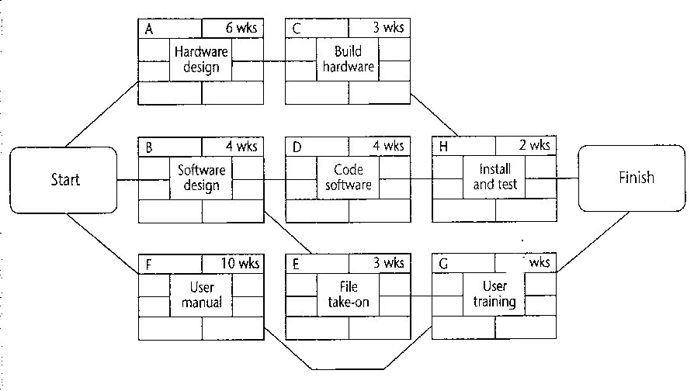
3

Slide 14
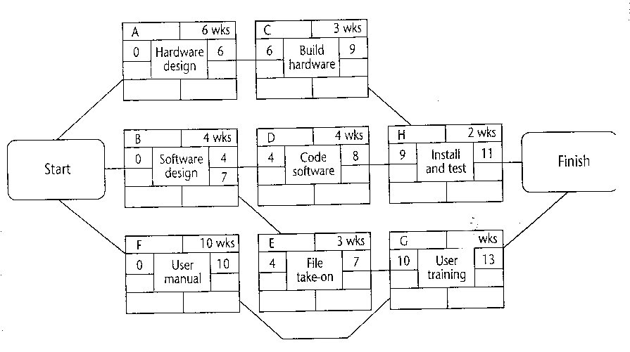
3

Slide 15
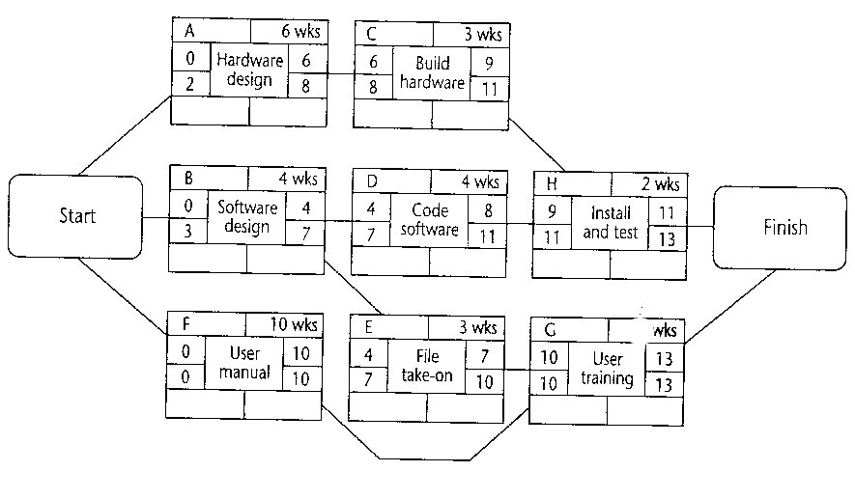
3
0
0

Slide 16
Schedule Compression
Crashing – Analyzing Schedule Compression with MINIMAL Cost Increase
Fast Tracking – Activities Which are Schedule to Perform in Sequence (Discretionary) will Perform in Parallel, This Will Add RISK to the Project

Slide 17
Apply Calendars
Project Calendar: ASSIGN ACTUAL DATES TO THE PROJECT SCHEDULE
Adjust Holidays and others “Vacation Days”
Resources Calendar
Non Availability of Resources On Certain Dates
Trainings Dates,
Working Hours Information (Part Time Employee)
Resource Leveling
Shared or Critical resources May be Limited or not Available in Certain Time.
The Project Management May Wish to Keep Some Resources at a Reasonable Stable Level.
These Will Require Adjustments to the Project Schedule
Generate Project Schedule Baseline for approval and tracking of the actual performance

Slide 18
Schedule Control
Reports the Current status of the project schedule
Detects the factors that create schedule change
Determine that the project schedule has changed
Manages the actual change as it occurs

Slide 19
Schedule Control Tools and Techniques
Progress Report – Current Schedule Status
Actual start and finish dates
Remaining duration for unfinished schedule activities
Schedule change control system
Paperwork, tracking system and approval levels for the schedule change procedure
Performance Measurements
Schedule Performance Index (SPI), Schedule Variance (SV)
Project Management Software
Variance Analysis: Compare Target schedule dates with actual/forecast ones. Used for deviation detection and correction activities (Example: A major delay in non critical path activity may have a small impact)
Schedule comparison bar chart

Slide 20
Schedule Control Outputs
Schedule Model Updates
Modifications to the project schedule model
Notification of appropriate changes to the stakeholders
New project schedule network diagram is developed
Schedule Baseline Update ( As a result of approved change requests)
Performance measurements
Requested changes
Recommended corrective actions
Lessons learned documentation – updates
Updates of relevant project’s sub planes

